Slide 1



CASE STUDY
Sentiment Analysis

Slide 2



1
Problem Statement
Agenda
Dataset & Preprocessing
2
Topics
3
Models
4
Performance Evaluation
Contains an overview of stages in the solution to the problem statement
5
Final Remarks

Slide 3



Problem Statement
Develop a sentiment analysis model to classify tweets into one of three sentiment categories: negative (-1), neutral (0), or positive (+1).

Slide 4



Dataset
There were two datasets train & test
Train dataset contains columns ‘Text’ & ‘category’
Test dataset contains column ‘Text’
Train dataset had 154278 rows
Test dataset had 12981 rows

Slide 5
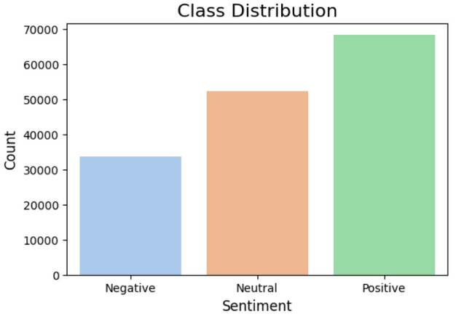
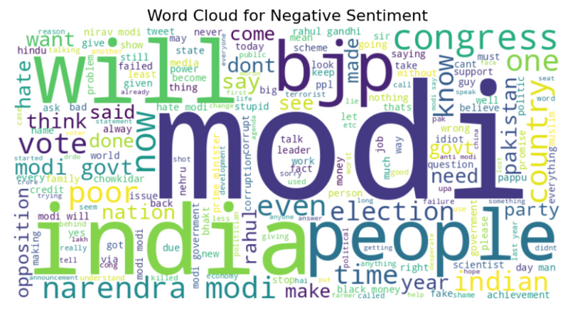
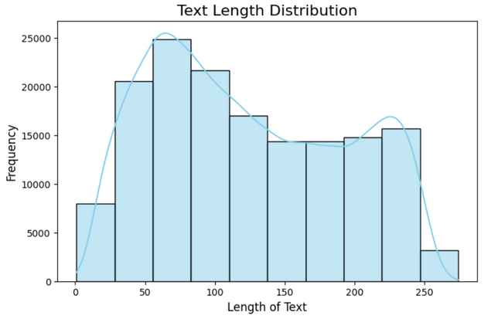
Exploratory Data Analysis
Class Distribution
Wordcloud
Text Length Distribution
Slightly imbalanced
Size of word represents frequency in dataset
Frequency distribution of Length

Slide 6


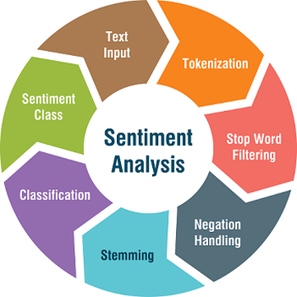
Preprocessing the Text
Several preprocessing steps
Change to lowercase
Removed URL, HTML tags, mentions
Removed emoji
Removed punctuation
Conversion of abbreviations
Removed stopwords
Stemming
Lemmatization

Slide 7
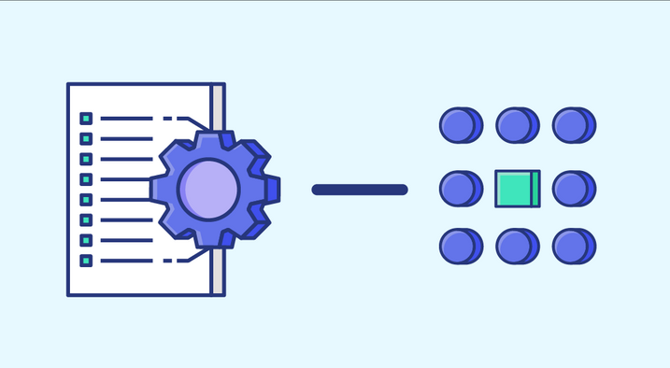
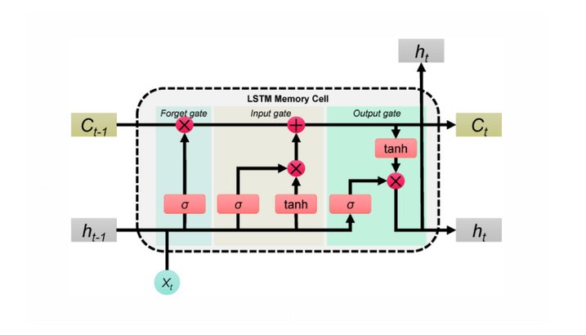
TF-IDF vectorization
Vectorization of both training & testing data with maximum features ~10,000
Feature Engineering
LSTM Tokenization
Maximum length of tokens in a single comment ~297
Number of words to be included in the tokenization ~50,000

Slide 8

MODELS
Naive Bayes
Accuracy ~ 0.70
LSTM
Accuracy ~ 0.83
RoBERTa LLM
Accuracy ~ 0.73

Slide 9


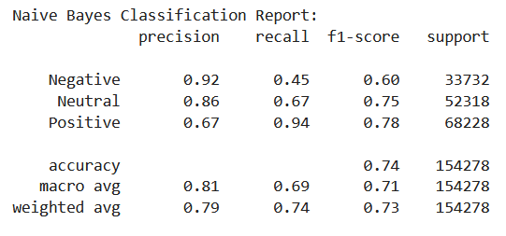


Precision ~ 0.79
NAIVE BAYES
Recall ~ 0.74
F1-Score ~ 0.73
Accuracy ~ 0.70

Slide 10
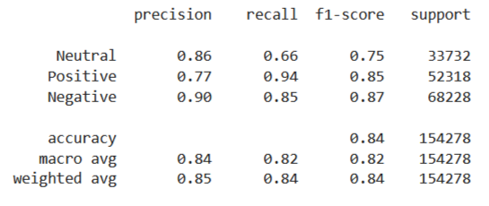
Precision ~ 0.81
LSTM
Recall ~ 0.85
F1-Score ~ 0.83
Accuracy ~ 0.83

Slide 11
Precision ~ 0.76
Recall ~ 0.72
RoBERTa LLM
F1-Score ~ 0.73
Accuracy ~ 0.73

Slide 12

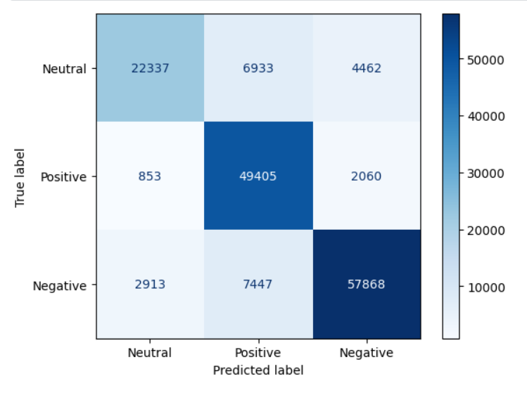
Confusion Matrix for best model
LSTM provided best f1-score on the data

Slide 13
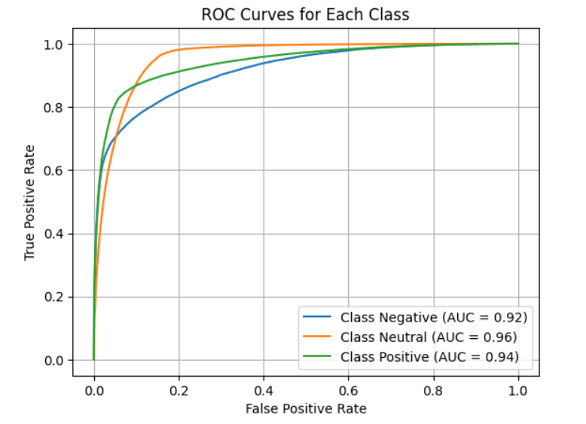
ROC-AUC Curve
LSTM provided best f1-score on the data

Slide 14


Thank you!

Slide 15









Resource
Page
Github Link to Project
Vivek Kumar

